Slide 1

APPLICATIONS TEXT PROCESSING String Algorithms Naïve Algorithm, Rabin Karp Algorithm,KMP Algorithm

Slide 2

The Naive String Matching Algorithm
The naïve approach tests all the possible placement of Pattern P [1.......m] relative to text T [1......n]. We try shift s = 0, 1.......n-m, successively and for each shift s. Compare T [s+1.......s+m] to P [1......m].
The naïve algorithm finds all valid shifts using a loop that checks the condition P [1.......m] = T [s+1.......s+m] for each of the n - m +1 possible value of s.

Slide 3
NAIVE-STRING-MATCHER (T, P)
1. n ← length [T]
2. m ← length [P]
3. for s ← 0 to n -m
4. do if P [1.....m] = T [s + 1....s + m]
5. then print "Pattern occurs with shift" s

Slide 4
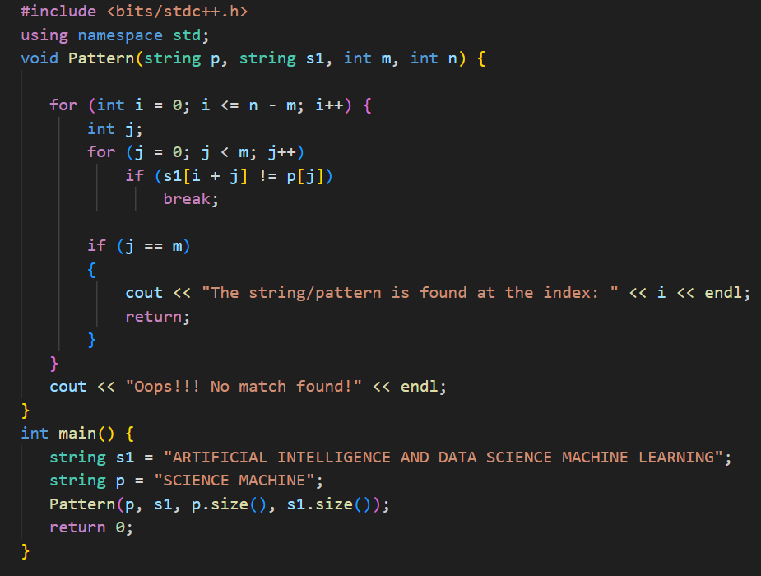

Slide 5
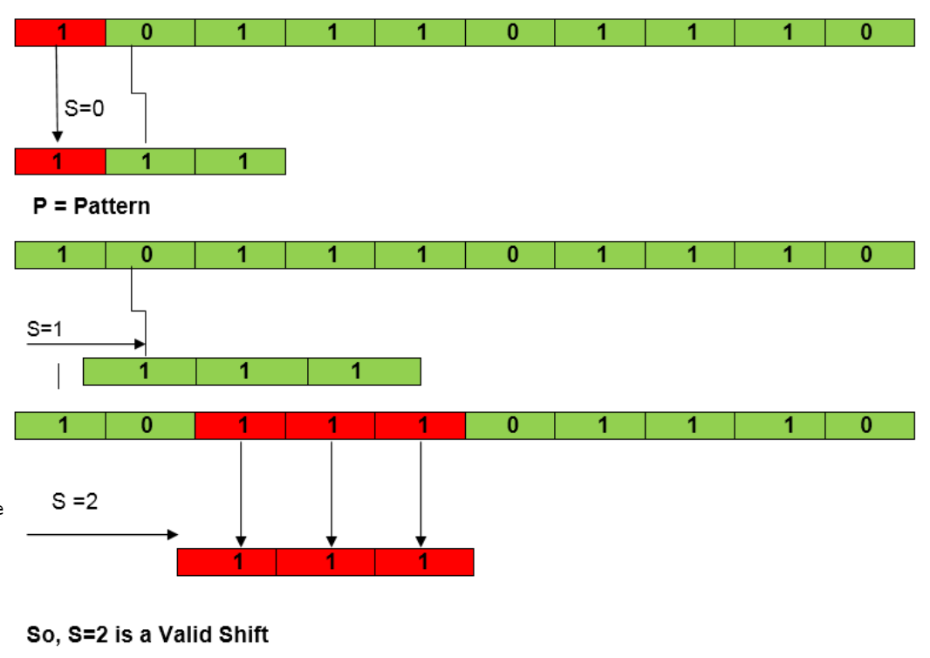
EXAMPLE Suppose T = 1011101110 ,P = 111 Find all the Valid Shift

Slide 6
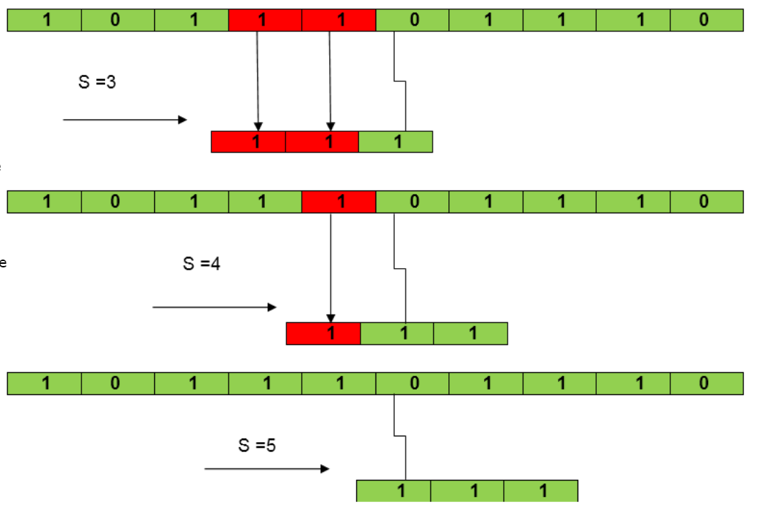

Slide 7
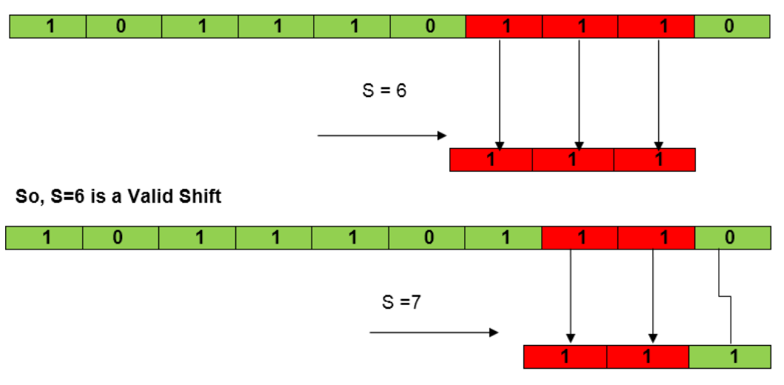

Slide 8
Rabin Karp Algorithm
The Rabin-Karp string matching algorithm calculates a hash value for the pattern, as well as for each M-character subsequences of text to be compared.
If the hash values are unequal, the algorithm will determine the hash value for next M-character sequence.
If the hash values are equal, the algorithm will analyze the pattern and the M-character sequence.

Slide 9
RABIN-KARP-MATCHER (T, P, d, q)
1. n ← length [T]
2. m ← length [P]
3. h ← dm-1 mod q
4. p ← 0
5. t0 ← 0
6. for i ← 1 to m
7. do p ← (dp + P[i]) mod q
8. t0 ← (dt0+T [i]) mod q
9. for s ← 0 to n-m
10. do if p = ts
11. then if P [1.....m] = T [s+1.....s + m]
12. then "Pattern occurs with shift" s
13. If s < n-m
14. then ts+1 ← (d (ts-T [s+1]h)+T [s+m+1])mod q

Slide 10
EXAMPLE: For string matching, working module q = 11, how many spurious hits does the Rabin-Karp matcher encounters in Text T = 31415926535.......
T = 31415926535.......
P = 26
Here T.Length =11 so Q = 11
And P mod Q = 26 mod 11 = 4
Now find the exact match of P mod Q...

Slide 11
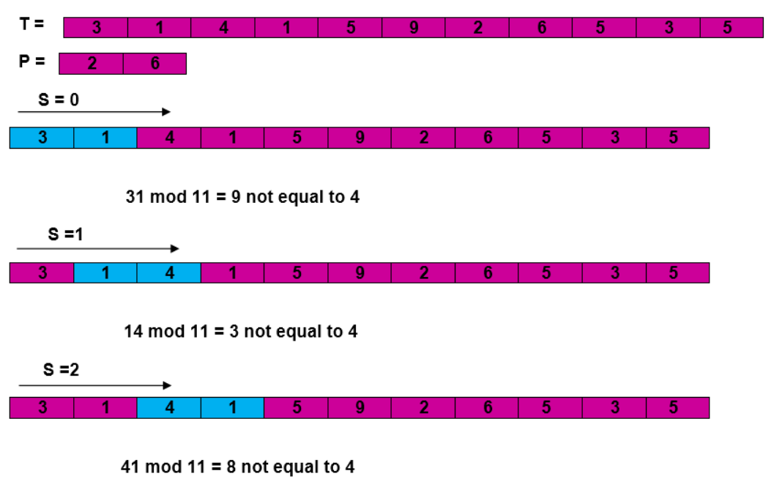

Slide 12
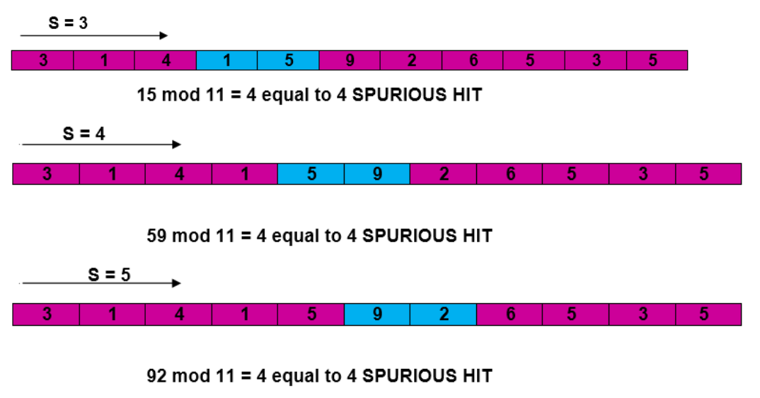

Slide 13
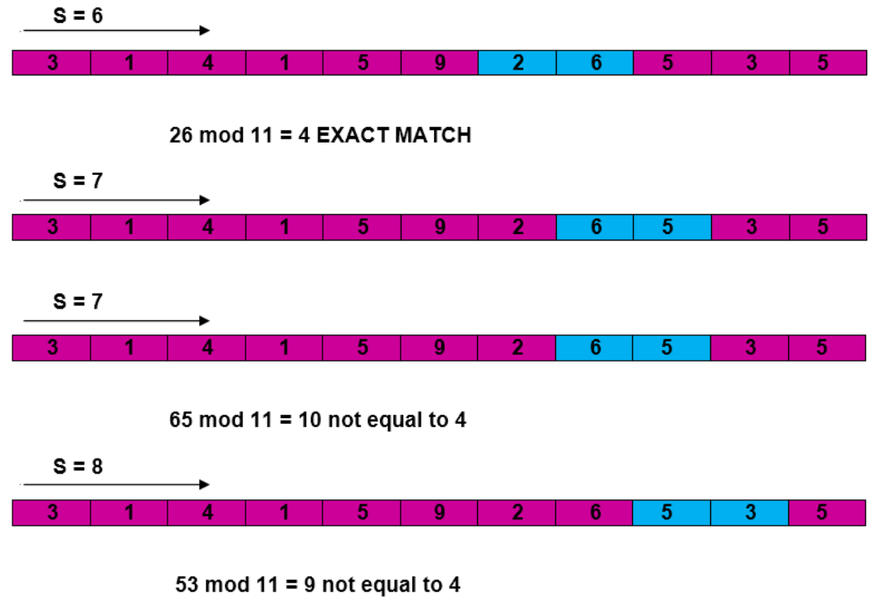

Slide 14
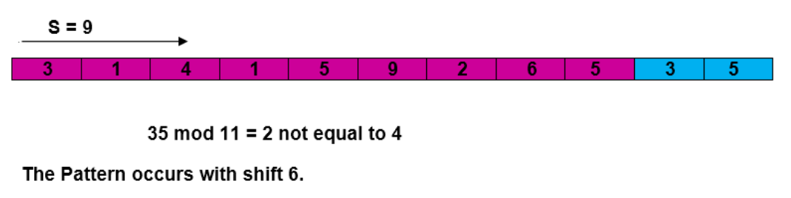

Slide 15
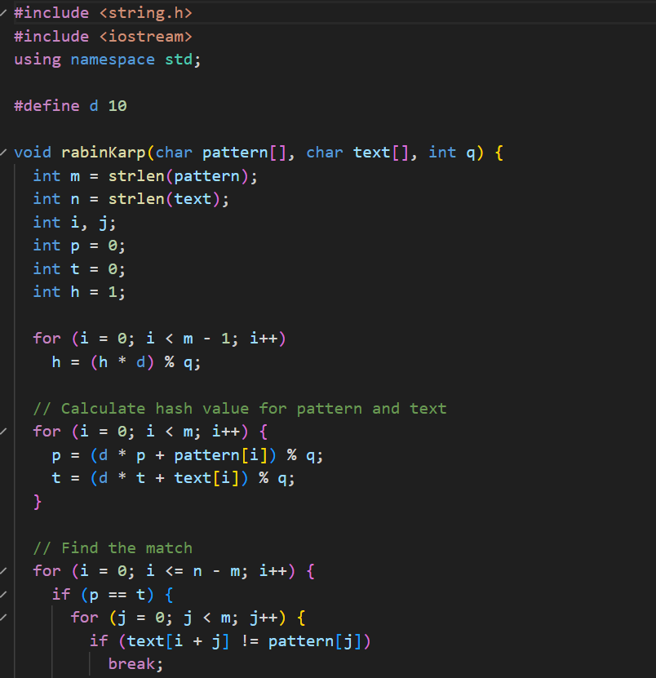
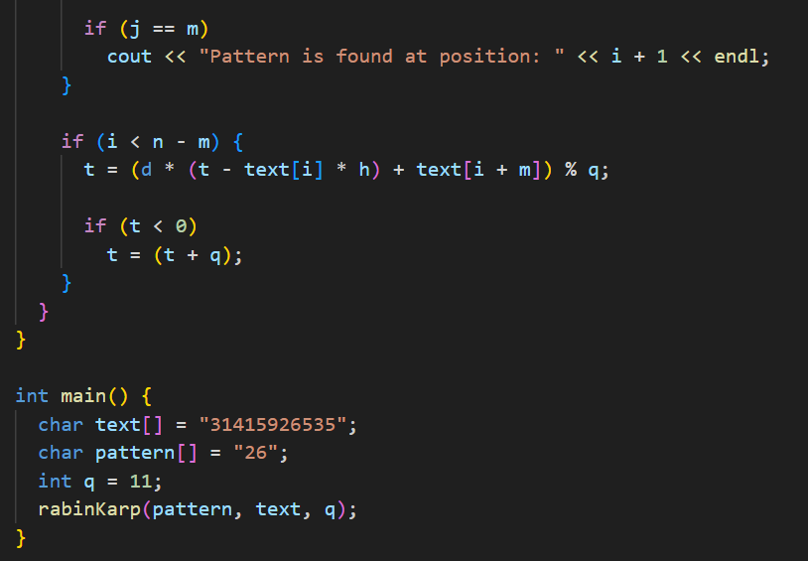

Slide 16
Knuth-Morris-Pratt (KMP) Algorithm
Knuth-Morris and Pratt introduce a linear time algorithm for the string matching problem.

Slide 17
Components of KMP Algorithm:
1. The Prefix Function (Π)
2. The KMP Matcher

Slide 18
The Prefix Function (Π)
COMPUTE- PREFIX- FUNCTION (P)
1. m ←length [P] //'p' pattern to be matched
2. Π [1] ← 0
3. k ← 0
4. for q ← 2 to m
5. do while k > 0 and P [k + 1] ≠ P [q]
6. do k ← Π [k]
7. If P [k + 1] = P [q]
8. then k← k + 1
9. Π [q] ← k
10. Return Π

Slide 19
Example: Compute Π for the pattern 'p' below
Initially: m = length [p] = 7
Π [1] = 0
k = 0

Slide 20
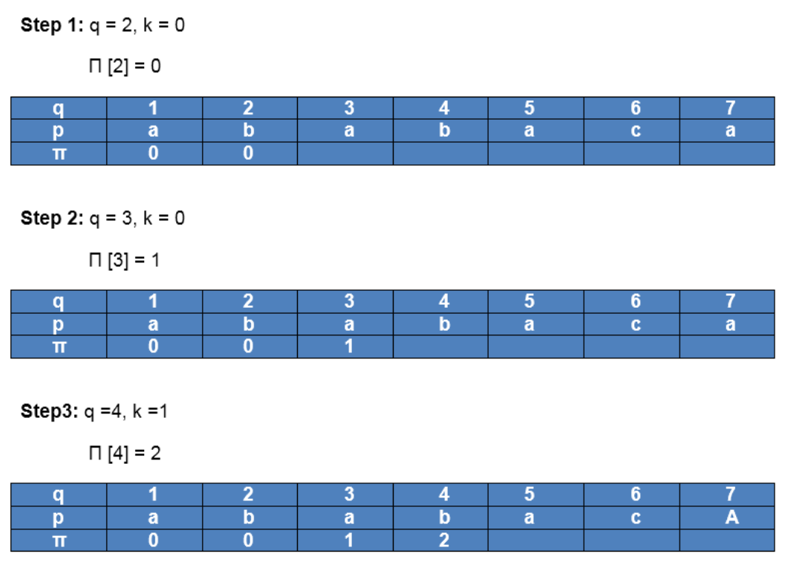

Slide 21
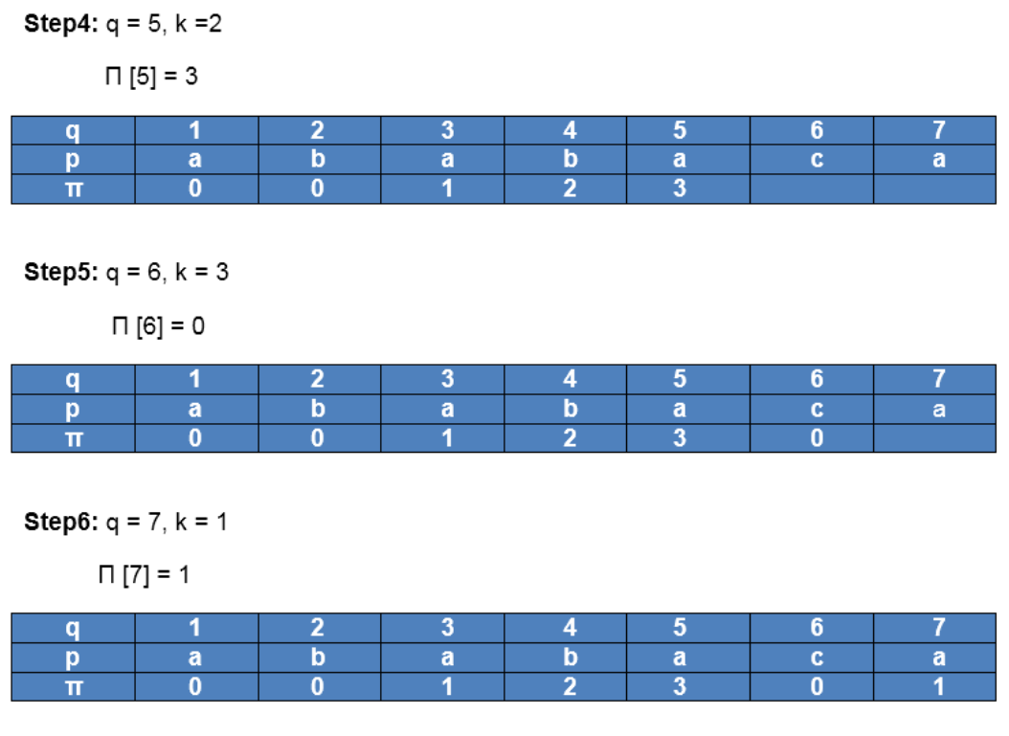

Slide 22
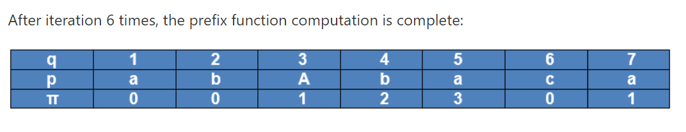

Slide 23
The KMP Matcher:
1. n ← length [T]
2. m ← length [P]
3. Π← COMPUTE-PREFIX-FUNCTION (P)
4. q ← 0 // numbers of characters matched
5. for i ← 1 to n // scan S from left to right
6. do while q > 0 and P [q + 1] ≠ T [i]
7. do q ← Π [q] // next character does not match
8. If P [q + 1] = T [i]
9. then q ← q + 1 // next character matches
10. If q = m // is all of p matched?
11. then print "Pattern occurs with shift" i - m
12. q ← Π [q] // look for the next match

Slide 24
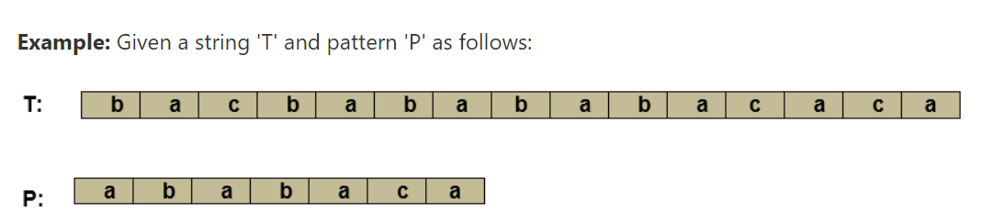
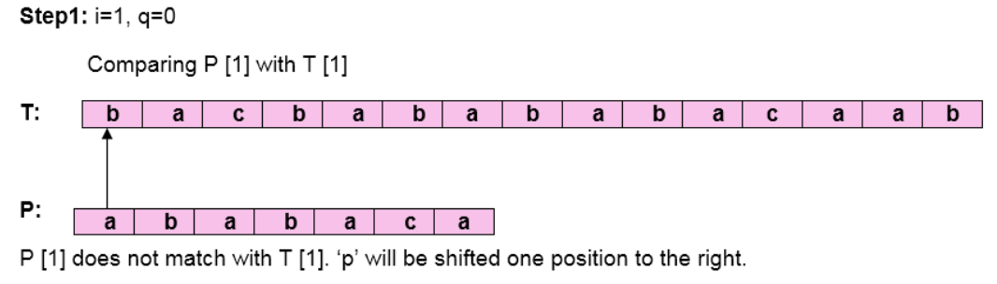
Initially: n = size of T = 15
m = size of P = 7

Slide 25
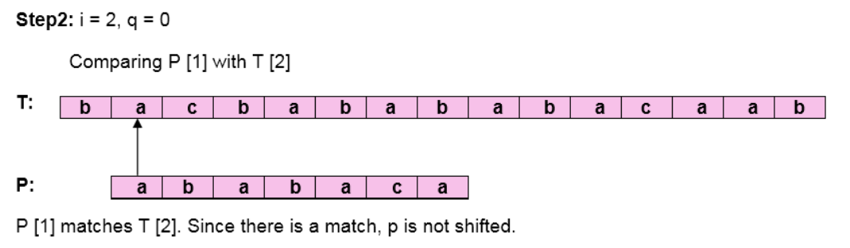
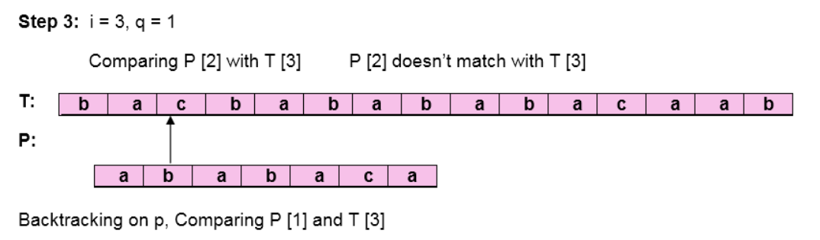

Slide 26
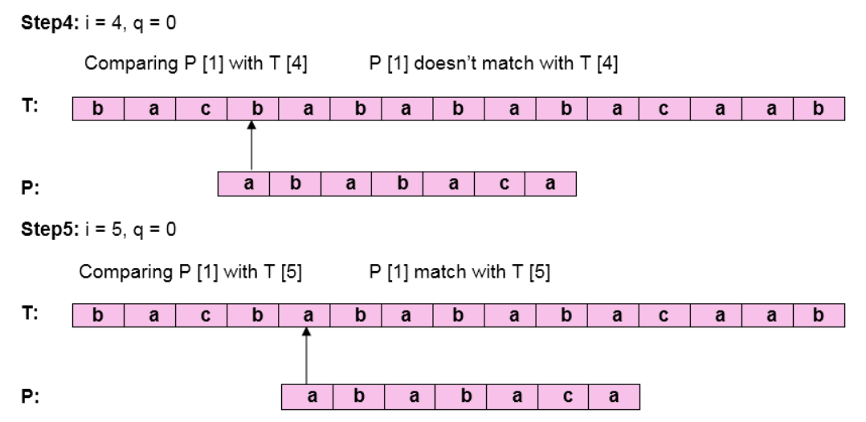

Slide 27
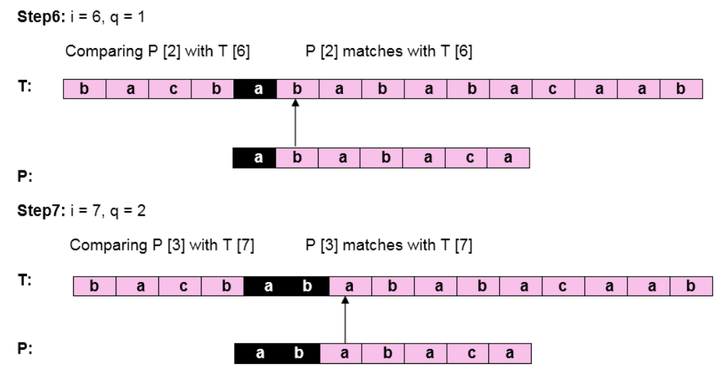

Slide 28
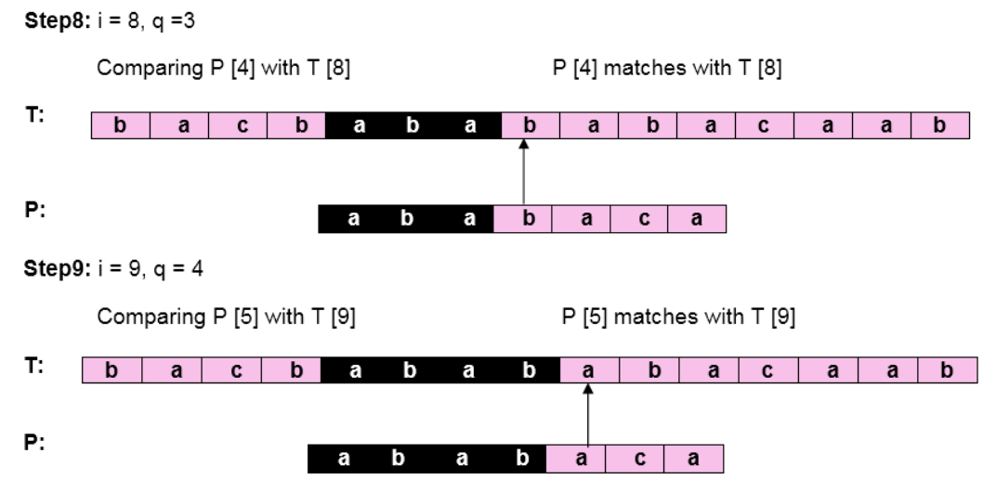

Slide 29
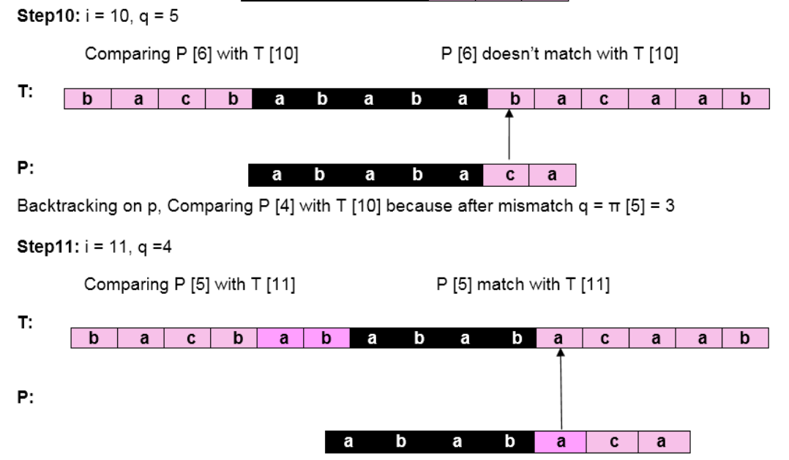

Slide 30
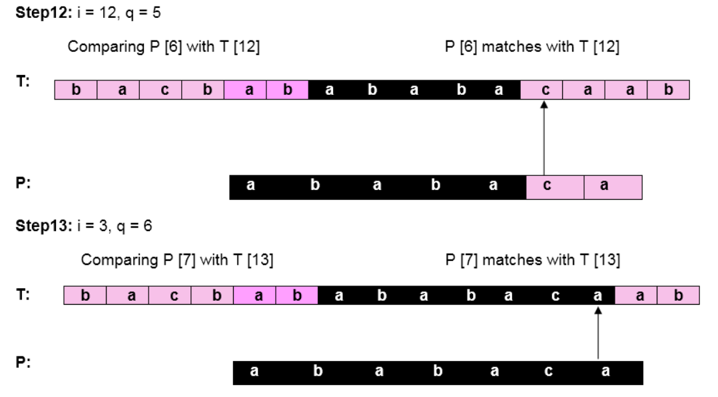
Pattern 'P' has been found to complexity occur in a string 'T.' The total number of shifts that took place for the match to be found is
i-m = 13 - 7 = 6 shifts.

Slide 31
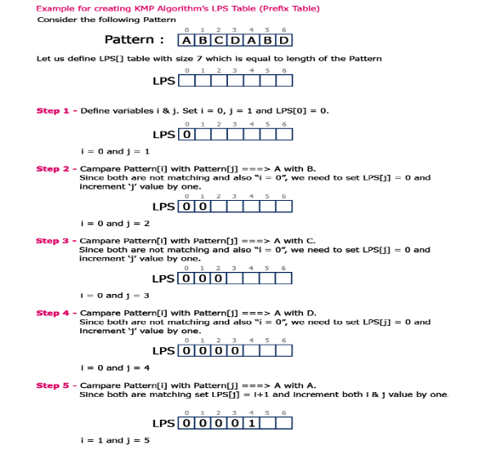

Slide 32
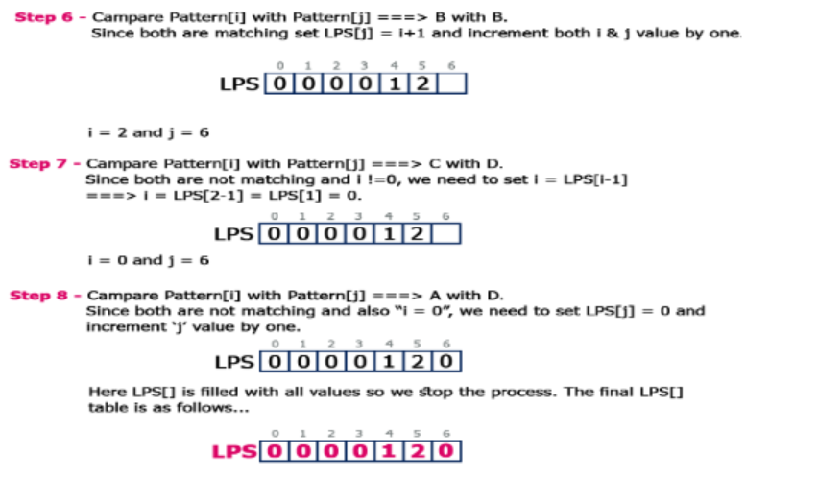

Slide 33
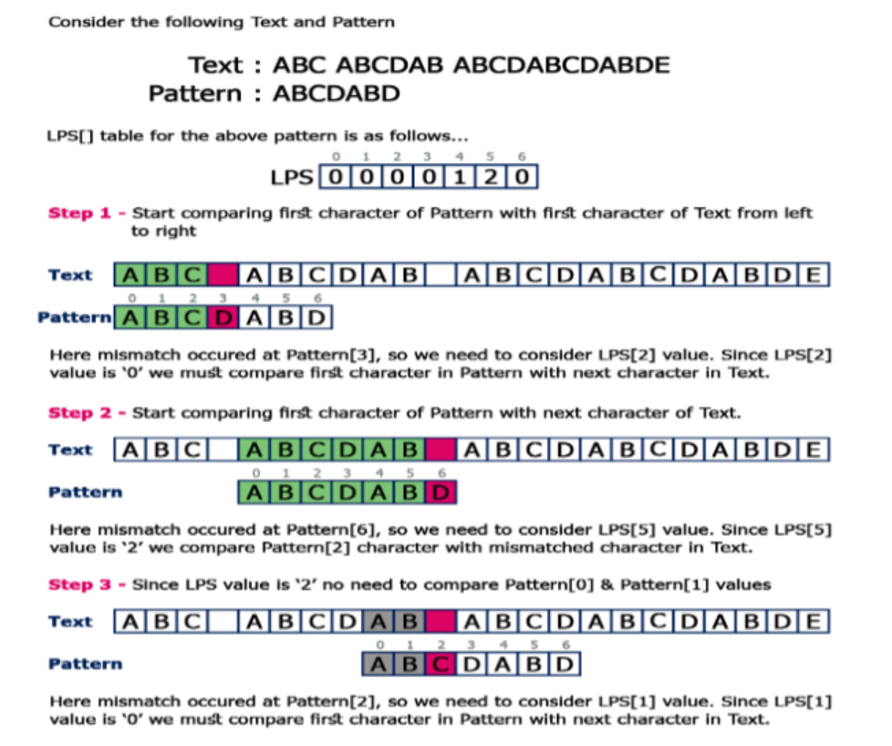

Slide 34
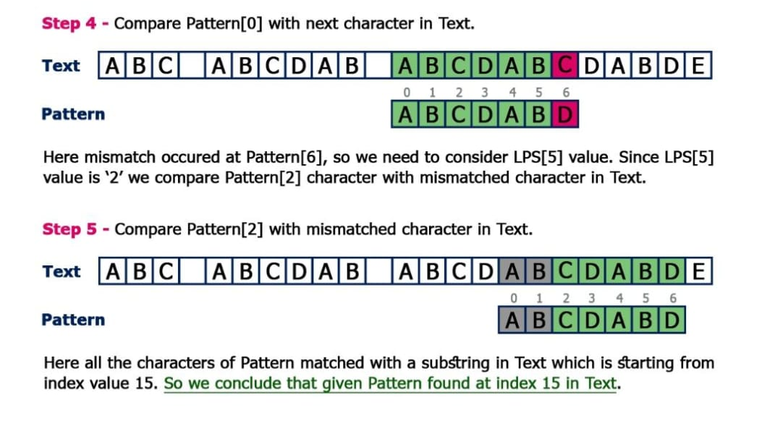

Slide 35
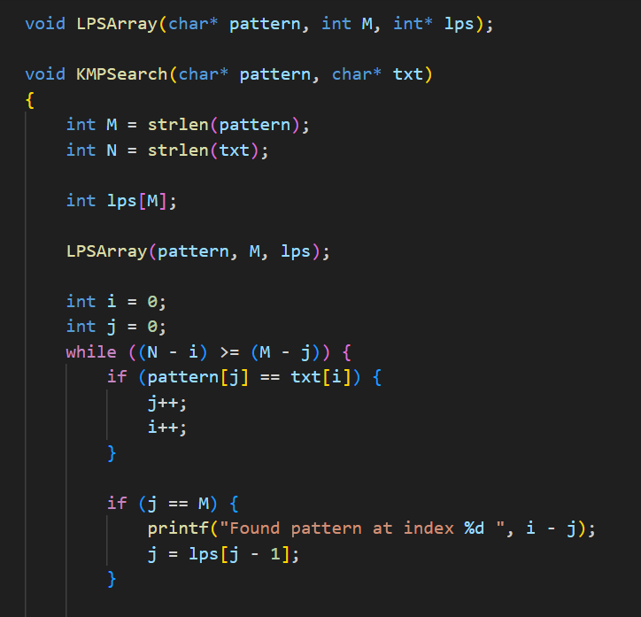
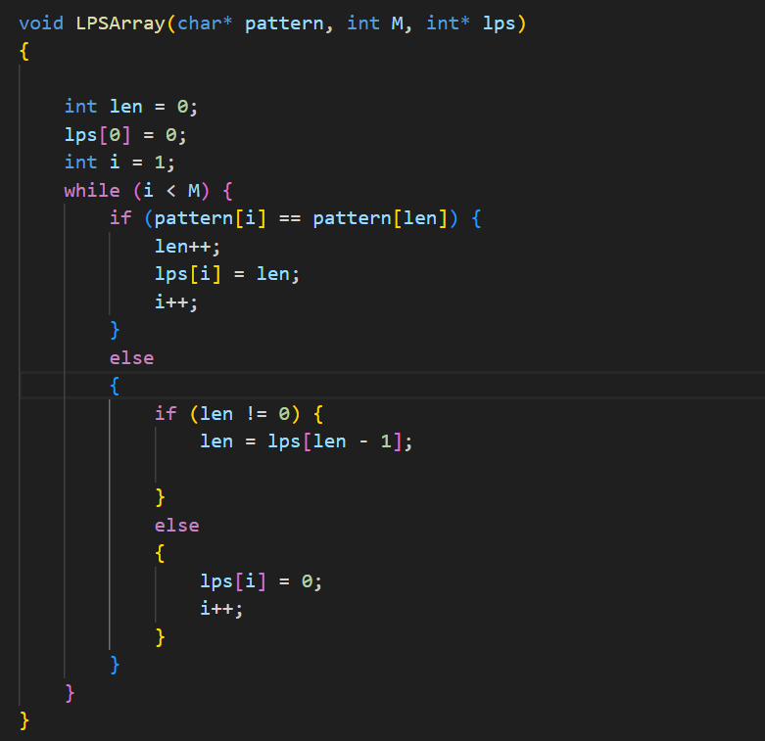

the running time of computing prefix function is O (m).

